Slide 1
Osher Lifelong Learning Institute, Spring 2025
Contemporary Economic Policy
University of Pittsburgh
Host: Jon Haveman, Ph.D.
Executive Director, National Economic Education Delegation

Slide 2
National Economic Education Delegation
Vision
  One day, the public discussion of policy issues will be grounded in an accurate perception of the underlying economic principles and data.
Mission
  NEED unites the skills and knowledge of a vast network of professional economists to promote understanding of the economics of policy issues in the United States.
NEED Presentations
  Are nonpartisan and intended to reflect the consensus of the economics profession.

Slide 3
Who Are We?
Honorary Board: 54 members
  2 Fed Chairs: Janet Yellen, Ben Bernanke
  6 Chairs Council of Economic Advisers
    Furman (D), Rosen (R), Bernanke (R), Yellen (D), Tyson (D), Goolsbee (D)
  3 Nobel Prize Winners
    Akerlof, Smith, Maskin
Delegates: 652+ members
  At all levels of academia and some in government service
  All have a Ph.D. in economics
  Crowdsource slide decks
  Give presentations
Global Partners: 48 Ph.D. Economists
  Aid in slide deck development

Slide 4
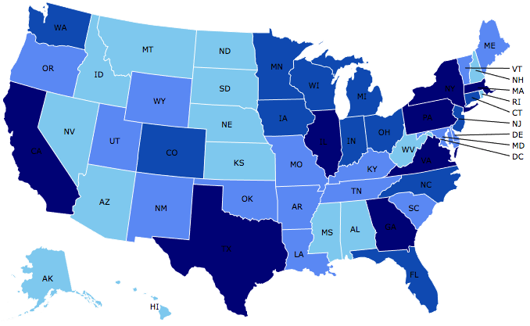
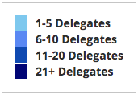
Where Are We?

Slide 5
Available NEED Topics Include:
US Economy
Healthcare Economics
Climate Change
Economic Inequality
Economic Mobility
Trade and Globalization
Minimum Wages
Immigration Economics
Housing Policy
Federal Budgets
Federal Debt
Black-White Wealth Gap
Autonomous Vehicles
US Social Policy

Slide 6
Course Outline
Contemporary Economic Policy
  Week 1 (5/15): Economic Update (Geoffrey Woglom, Amherst College)
  Week 2 (5/22): Economics of Immigration (Jon Haveman, Exec Director, NEED)
  Week 3 (5/29): Health Economics (Jon Haveman, Exec Director, NEED)
  Week 4 (6/5): Federal Debt and Deficits (Brian Peterson, Lagrange College)
  Week 5 (6/12): Trade and Tariffs (Tibor Besedes, Georgia Institute of Technology)

Slide 7
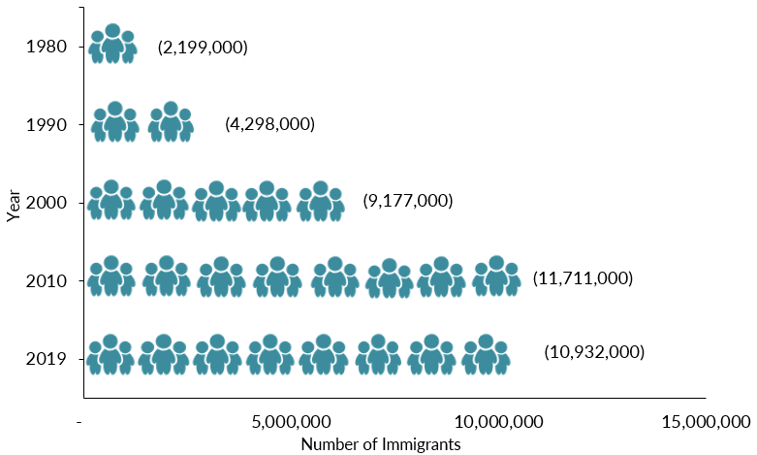
Mexican-Born People in the US
About 10.6 million in 2022 (Latest data)
1 in 14 people born in Mexico currently lives in the US

Slide 8
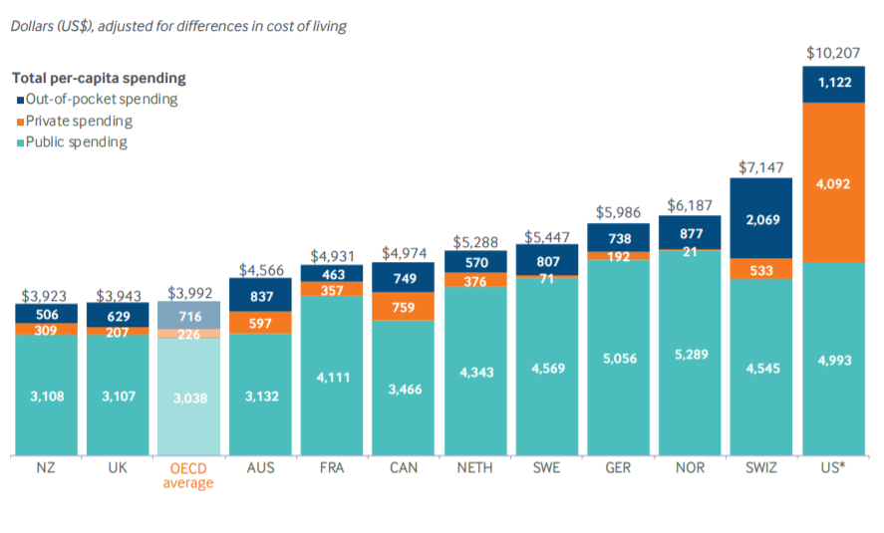
International Per Capita Healthcare Spending
US spends more than twice the OECD average
Source: Roosa Tikkanen and Melinda K. Abrams, U.S. Health Care from a Global Perspective, 2019: Higher Spending, Worse Outcomes (Commonwealth Fund, Jan. 2020).
Notes:
Some good resources:
https://www.commonwealthfund.org/publications/issue-briefs/2020/jan/us-health-care-global-perspective-2019
A bit older report: https://www.commonwealthfund.org/publications/issue-briefs/2015/oct/us-health-care-global-perspective
https://www.healthsystemtracker.org/chart-collection/quality-u-s-healthcare-system-compare-countries/#item-overall-age-specific-potential-years-of-life-lost-per-100000-population-1990-2017
https://axenehp.com/international-healthcare-systems-us-versus-world/

Slide 9
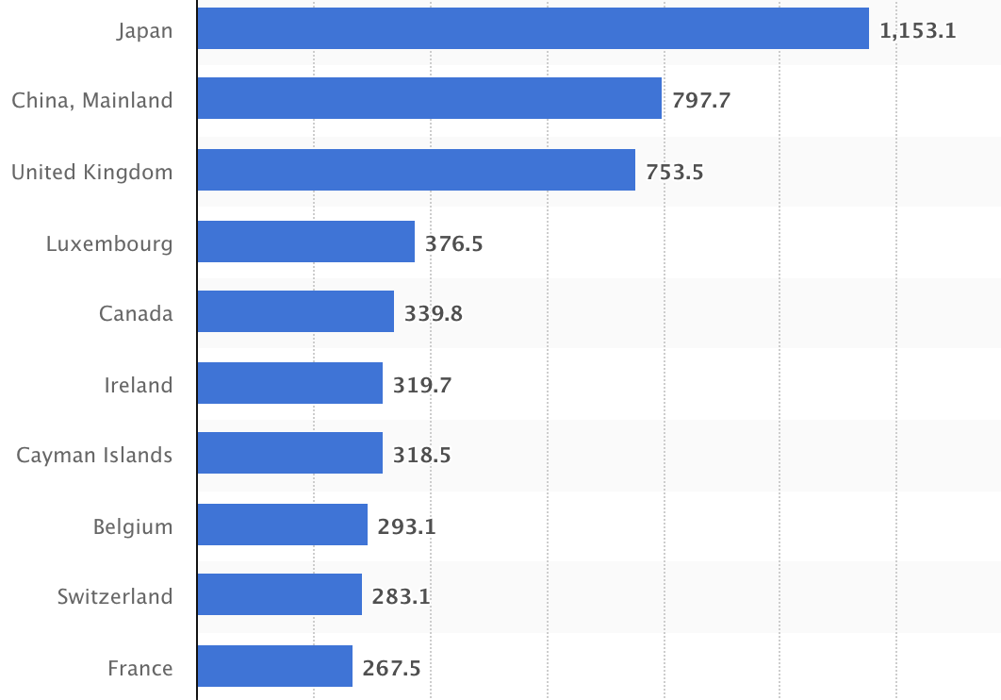
Who Holds Debt to Foreigners,
Foreign ownership is relatively recent
– in 1990 foreign ownership was less than 20%
– peaked at 40+%
– now is 29.4%
Billions of U.S. Dollars
Source: https://www.statista.com/statistics/246420/major-foreign-holders-of-us-treasury-debt/

Slide 10
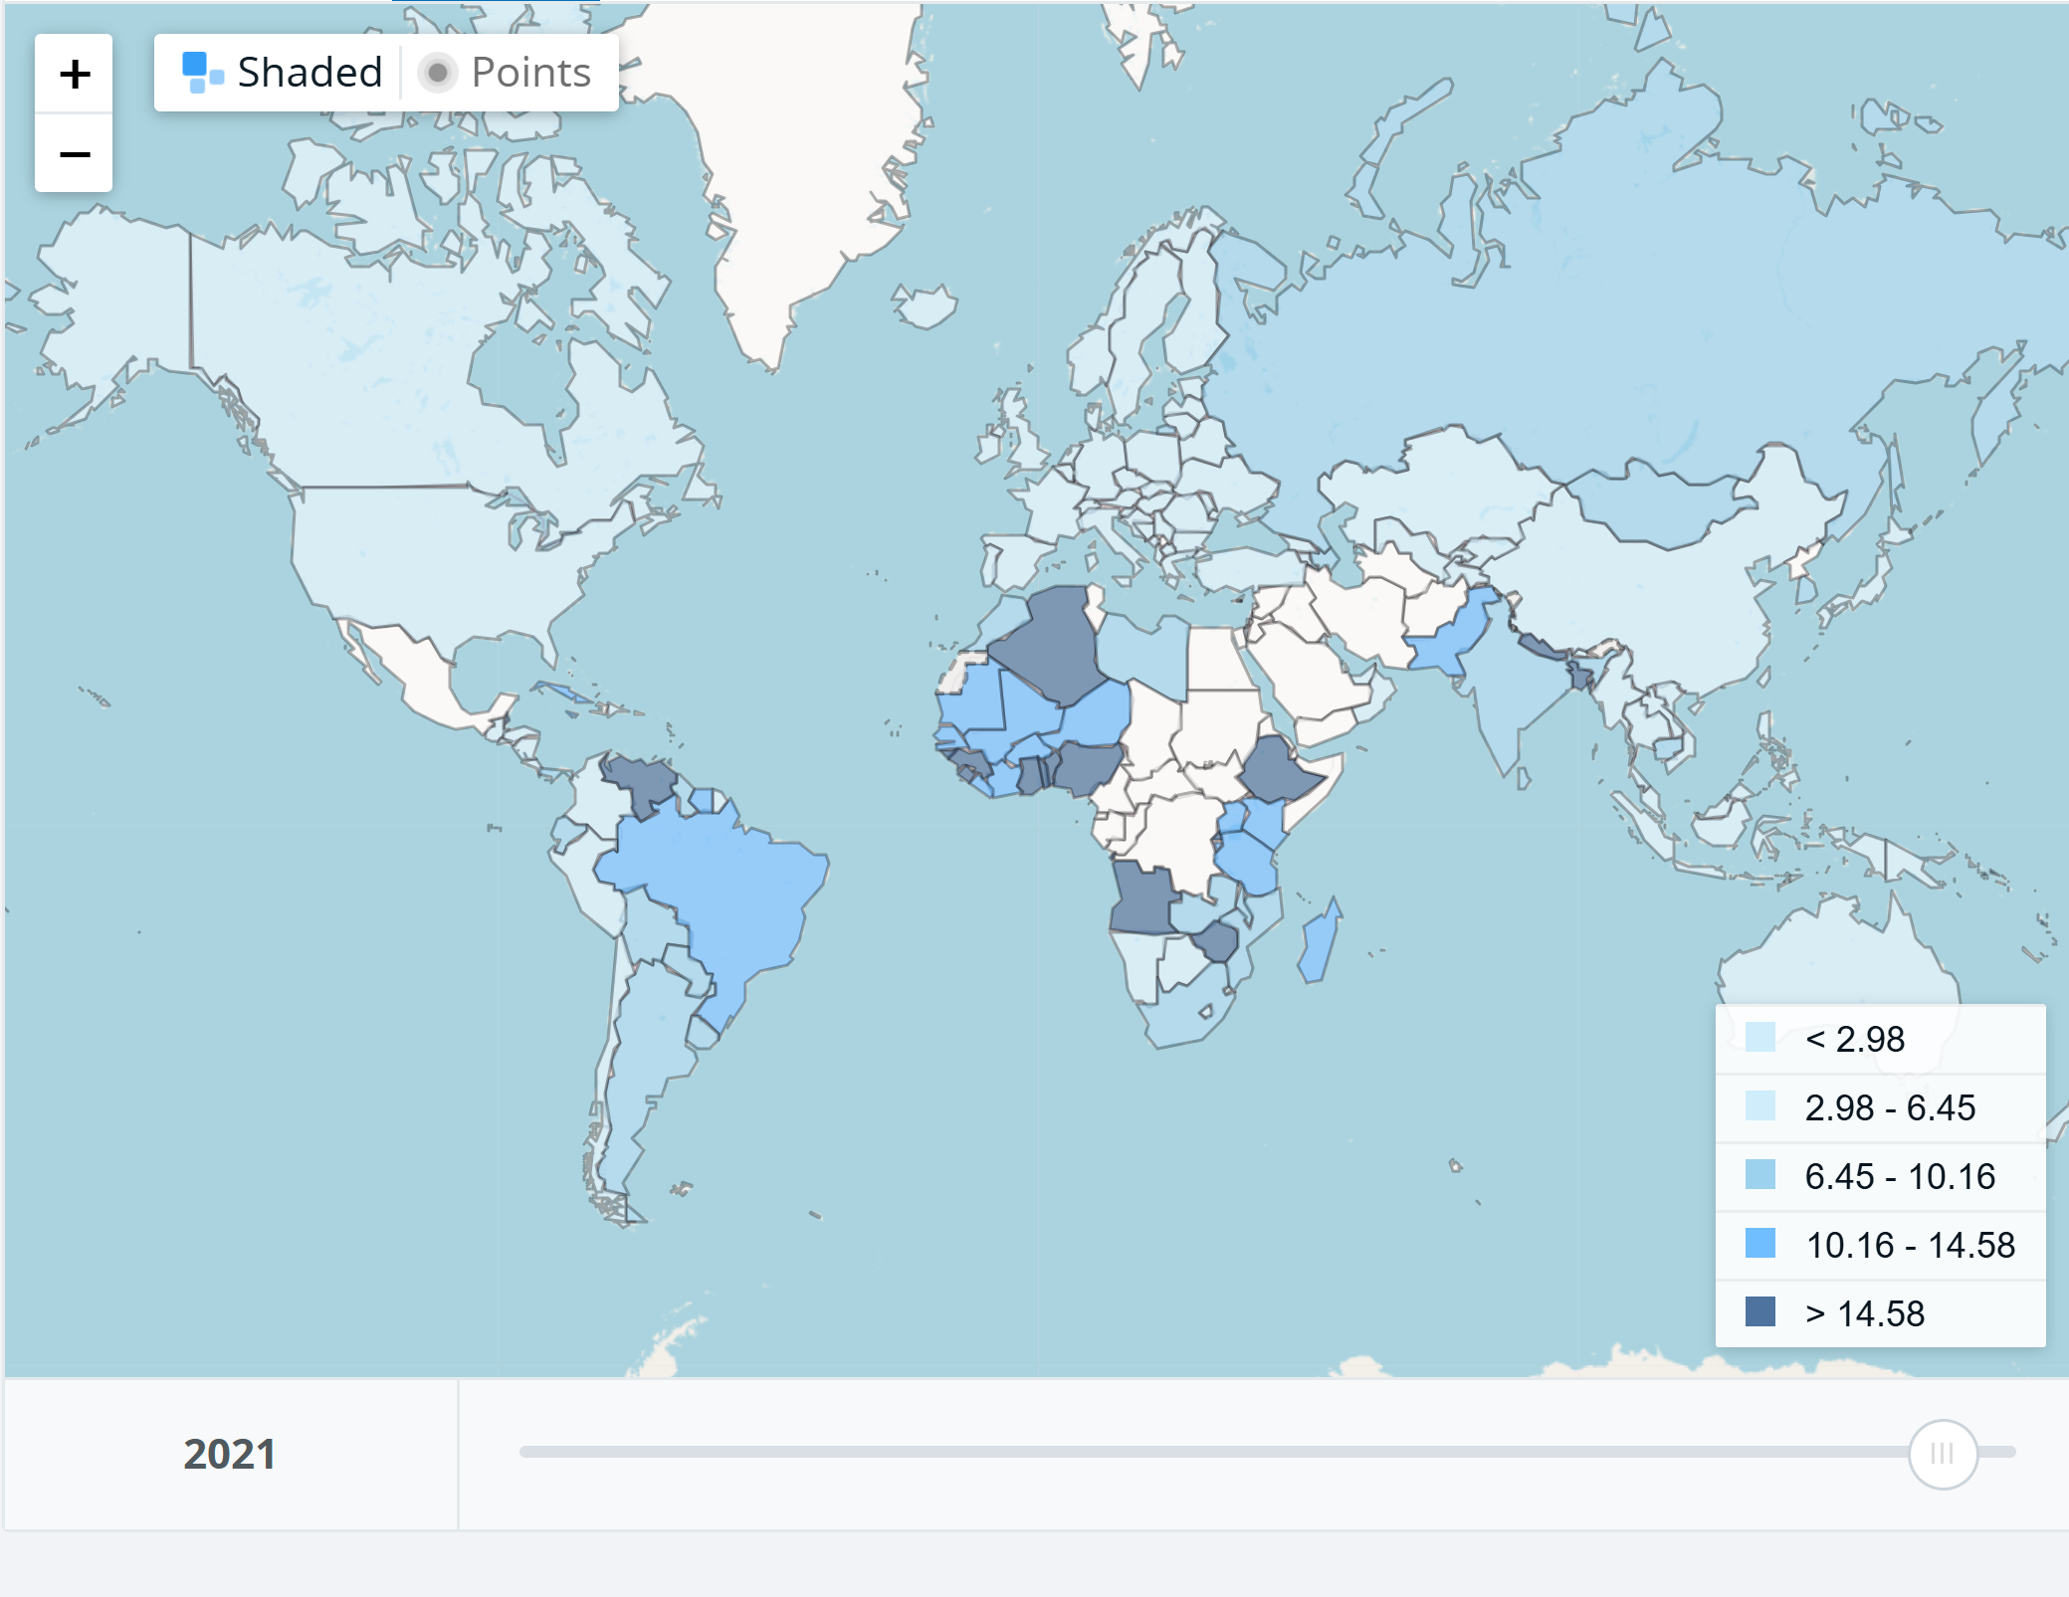
Tariffs in 2021
Key Takeaway:
Tariffs have been generally very low
1.33%
1.47%
2.31%
https://wits.worldbank.org/CountryProfile/en/Country/BY-COUNTRY/StartYear/1988/EndYear/2022/TradeFlow/Import/Indicator/AHS-WGHTD-AVRG/Partner/WLD/Product/Total

Slide 11
Submitting Questions
Submit questions in the chat or raising your digital hand. I will try to address questions as they come up.
We will do a verbal Q&A once the material has been presented.
Slides will be available from the NEED website tonight (https://www.needecon.org/delivered_presentations.php).
My macro site: https://sites.google.com/view/macro-current-issues/economic-update

Slide 12
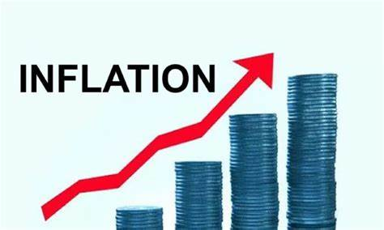

US Economy: Update
Geoffrey Woglom,
Professor of Economics
Amherst College, emeritus
May 15, 2025

Slide 13
Outline for the Talk
Overview on the State of the Macro Economy.
Describe the Current Uncertainty.
Explain why the Trump tariffs create a dilemma for the Fed.
Congressional Republican plans for taxes and spending.
Citizen’s Guide to Budget Reconciliation.

Slide 14
Gross Domestic Product: 2024 = $29.2 tr
$30.1
Less Imports (IM)
-$4.1
Plus Exports (EX)
+$3.2
Equals GDP (Y)
$29.2
$30.1
Less Trade Deficit
Exports (EX)- Imports (IM)
$3.2 -$4.1 =$ -0.9
Equals GDP (Y)
$29.2

Slide 15
Basic GDP Accounting
Trade Deficit is when imports (IM) exceed exports (EX)
Trade Deficits arise when we spend domestically more than we produce
Y - C - I – G = -IM + EX, $29.2-$30.1=-$0.9
Useful definition Y – C – G is “National Saving” & rearranging;
(Y – C - G )– I = National Saving less Investment = -IM + EX = Trade Deficit
We spend more than we produce when national saving isn’t sufficient to finance our investment, so we borrow from abroad.
Trade Deficit = Borrowing from foreigners = National Saving less Investment.
Key Takeaway: Trade Deficits are Associated with an imbalance of national saving and investment

Slide 16
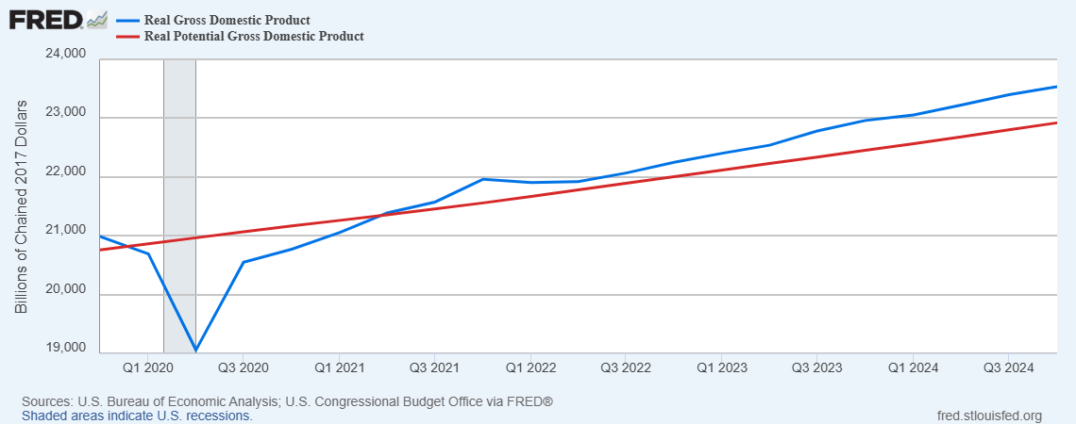
GDP and ‘Potential’ during the Recovery
Grey bar indicates recessions
Source: Fred, St Louis Fed

Slide 17
What is a Recession?
Defined by the National Bureau of Economic Research (NBER)
“The NBER's definition emphasizes that a recession involves a significant decline in economic activity that is spread across the economy and lasts more than a few months.”
Popular Rule of Thumb: Two or more, consecutive quarters where Real GDP falls. (Doesn’t always work!)
Recessions are caused by a drop in total spending (remember the consumer).

Slide 18
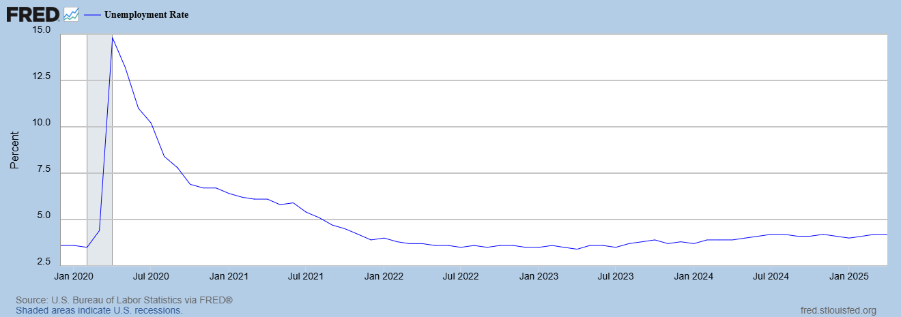
Unemployment is Near Record Lows

Slide 19
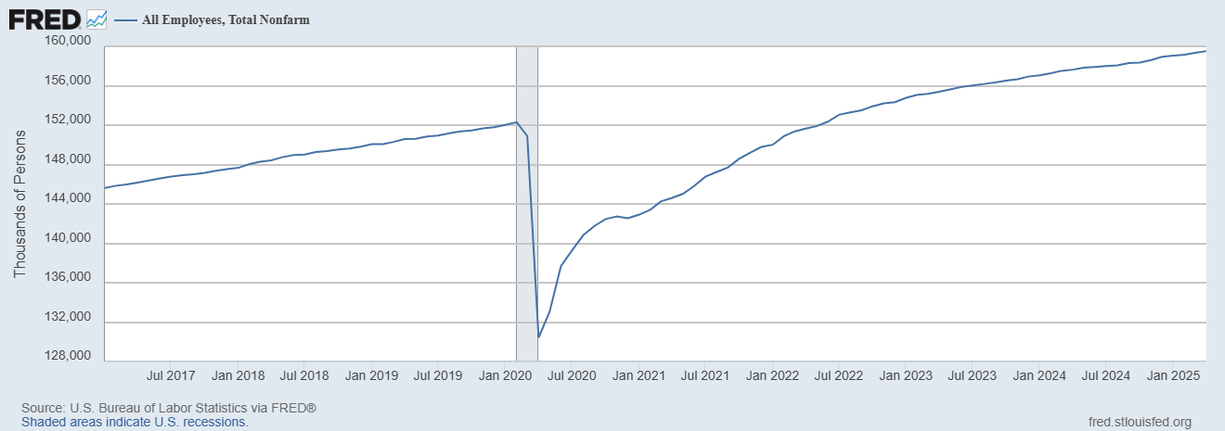
Where Have All the Workers Gone?
Source: Fred, St Louis Fed

Slide 20
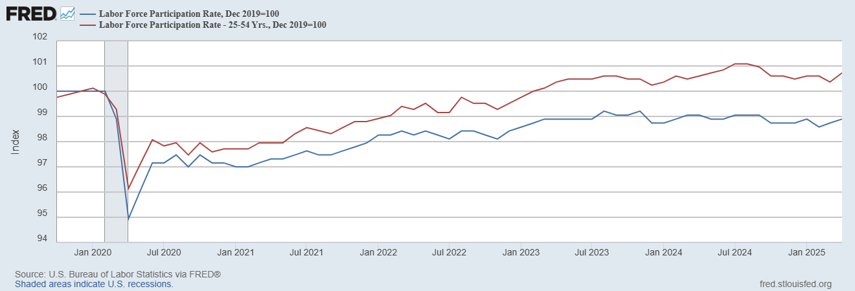
The Aging of the Labor Force
Notes:
F

Slide 21
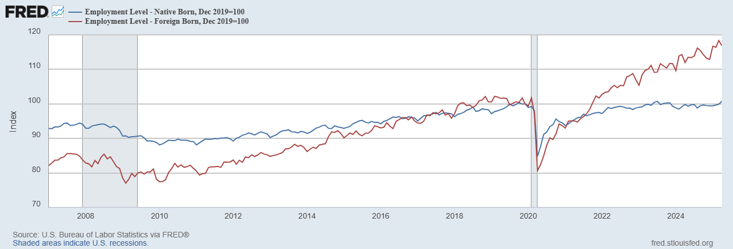
Supplemented by Foreign Workers
Between 11/19 and 4/25
NB employment rose by 1000k
FB employment rose by 4000k

Slide 22
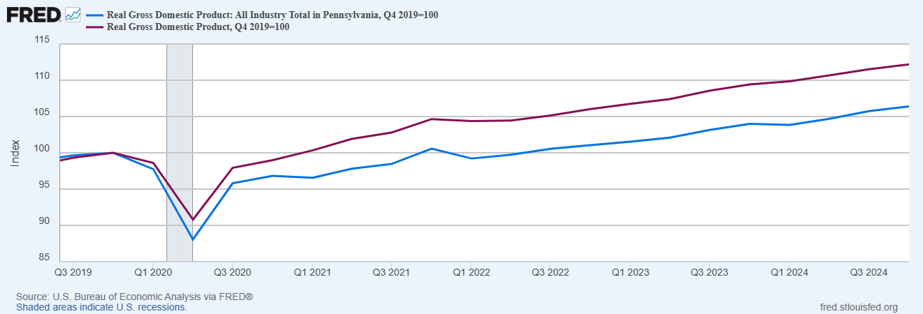
How is Pennsylvania Doing?

Slide 23
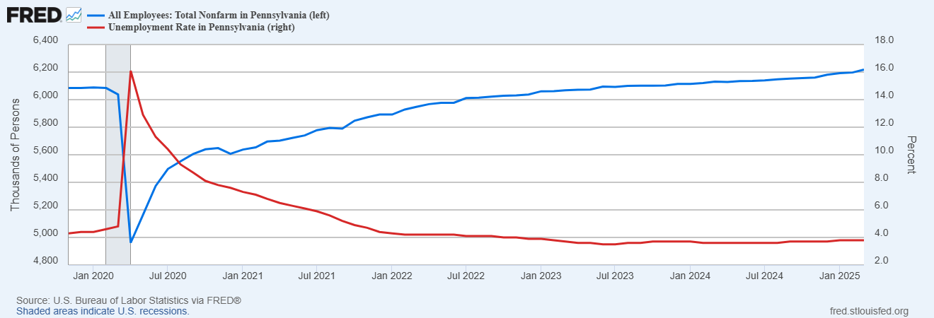
Labor Market in Pennsylvania
Employment growth since 12/2019, 2.1%; vs. 4.7% nationally
Notes:
REI about 1% increase in employment vs. 4.3

Slide 24
Overall Good News on the Real Side
GDP is very close to its potential.
The labor market as measured by the unemployment rate is fully recovered.
But there is also a nominal side: interest rates, asset prices, inflation and wages.
News is pretty good, but progress on inflation seems to have stalled.

Slide 25
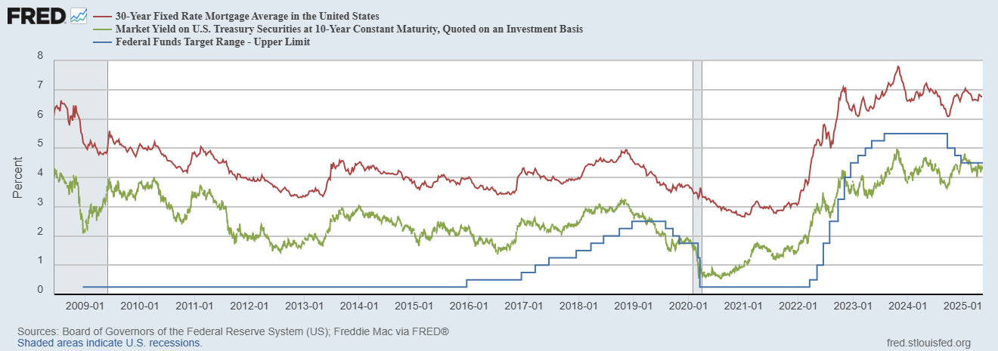
Interest Rates: Era of Falling Rates Over?
Notes:
Fed policy rate 4.5 to 4.25. Concerns with inflation

Slide 26
National Housing Market and Closer to Home
https://www.zillow.com/research/data/

Slide 27
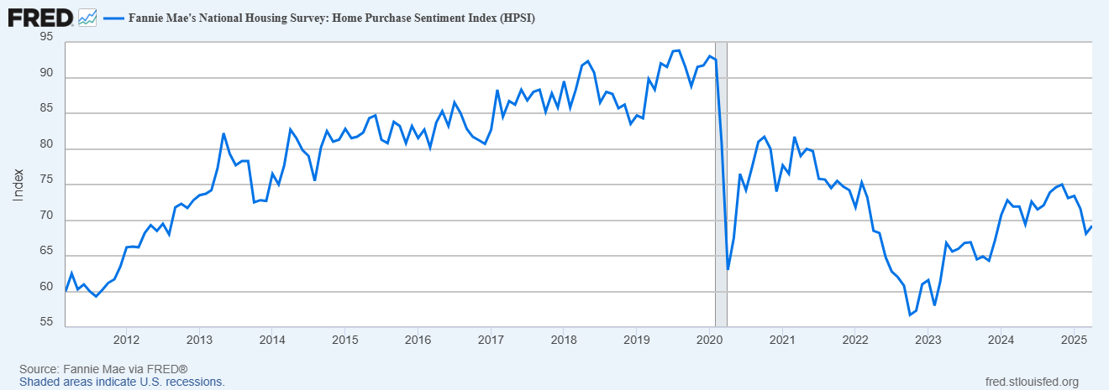
The Housing Market Could Be Worsening?

Slide 28
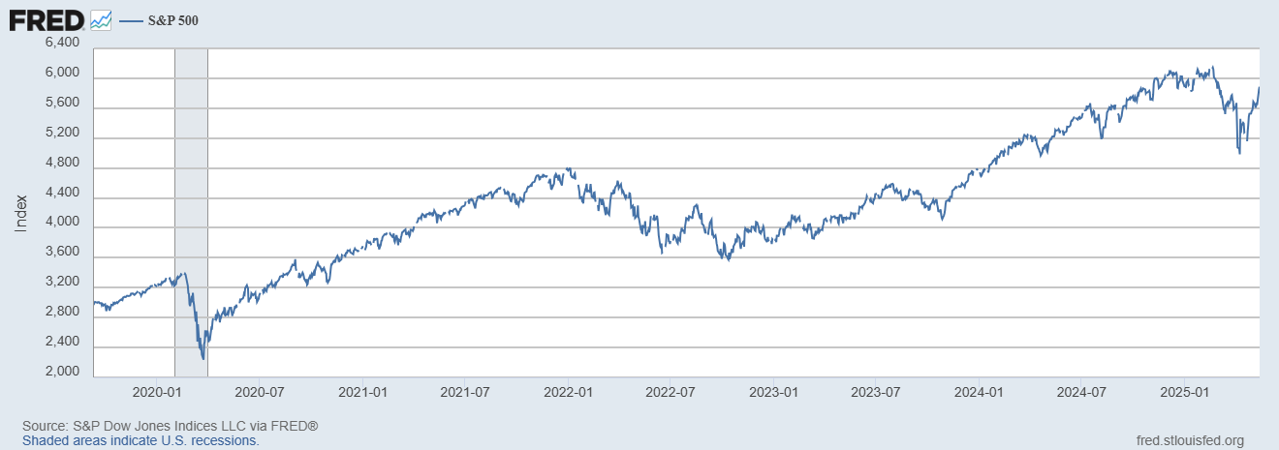
Stock Prices: Its OK to Look at Your 401K Again
Notes:
Since the end of 2021, lost almost 15%

Slide 29
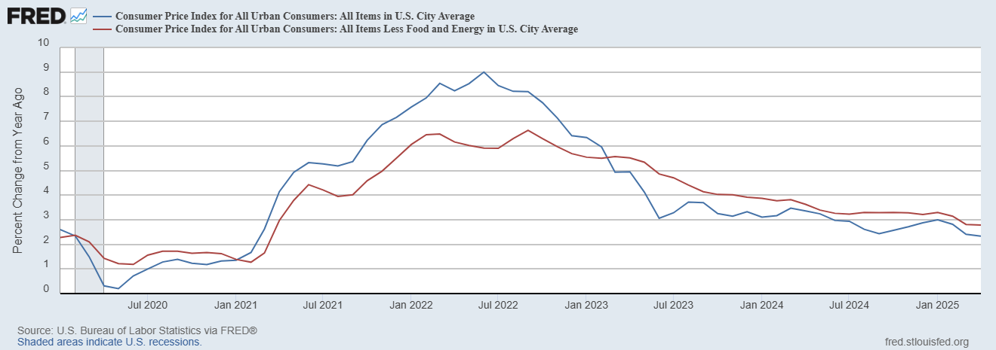
Inflation during the Recovery (CPI)
Notes:
August CPI yoy 8.3% down from 8.5 and Core 6.3 up from 6.3 in JUly

Slide 30
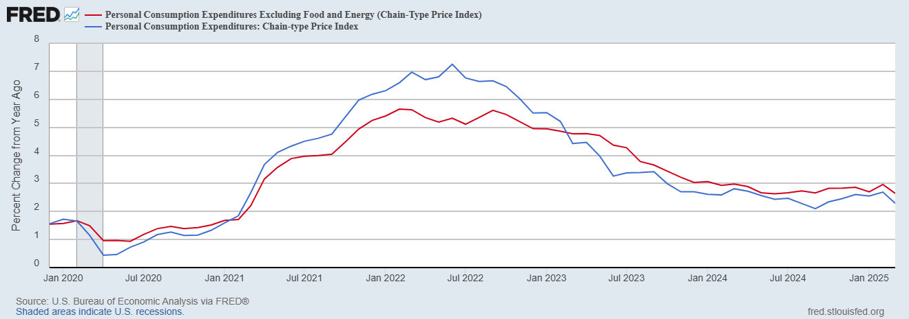
Fed’s Measure (PCE)
Inflation Accelerates 3/2021
Fed Doesn’t React until 3/2022
Progress slows Spring 2024

Slide 31
CPI vs. PCE: Differences
CPI tends typically to be 0.3 pct point higher
Mar:
CPI, 2.4%
PCE, 2.3%
Core CPI, 2.8%
Core PCE, 2.6%.
https://www.morningstar.com/markets/whats-difference-between-cpi-pce

Slide 32
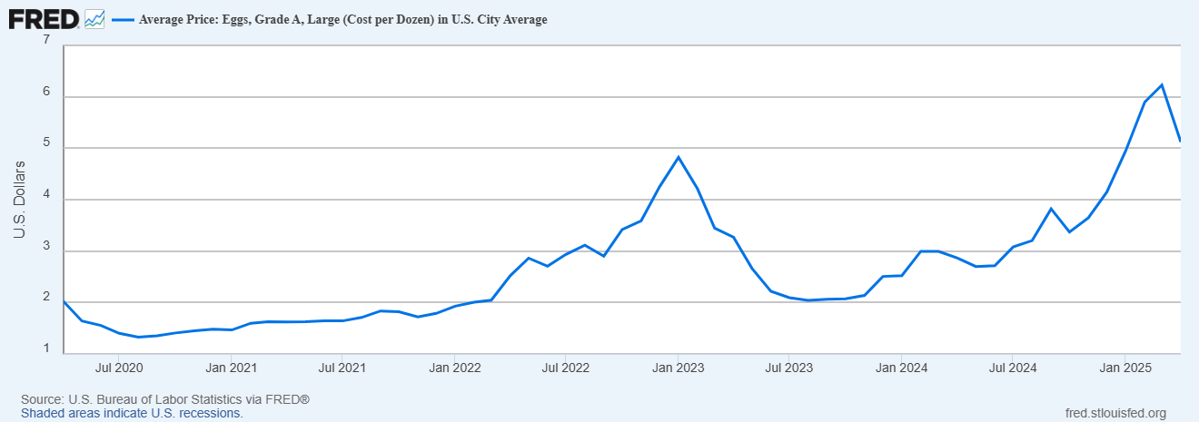
Uses of Inflation Measures
Two Reasons for Measuring Recent Inflation:
What has happened to the Cost of Living?
What is likely to happen to inflation over the next 12-18 months?

Slide 33
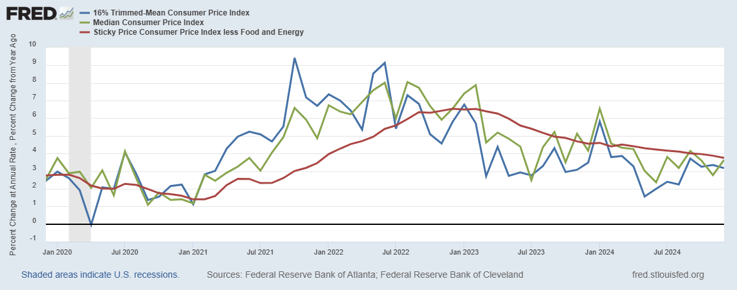
Measuring “Underlying” Inflation
Notes:
Super Core has a weight of less than 30% in the overall CPI

Slide 34
Measuring the Cost of Housing

Slide 35
Wages Have Finally Caught Up to Inflation
Federal Reserve of Atlanta, “Wage Tracker” and BLS
Notes:
But, note that low wage workers are doing relatively the best

Slide 36
International Comparisons
IMF, World Economic Outlook, 4/2025

Slide 37
TheSState of the Economy & Policy Effects
In terms of output and employment the economy is fully recovered
Inflation is still a bit elevated, but close to Fed target.
Policy Effects
Biden Fiscal Stimulus led to a rapid recovery, but may have been too big.
Fed reacted too little and too late and let inflation get out of control.
But since Spring 2023, Fed has been close to perfect.
But Dark Clouds Are Looming on the Horizon,

Slide 38
Consumer’s Are Not Happy (2/3rds of GDP)

Slide 39
They Are Worried about Inflation

Slide 40
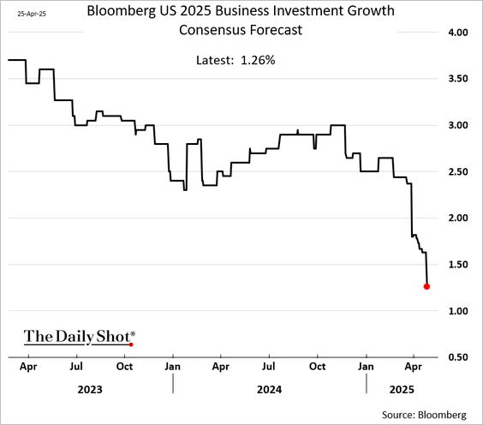
Busineses aren’t Too Happy Either

Slide 41
Professional Forecasters Are Worried

Slide 42
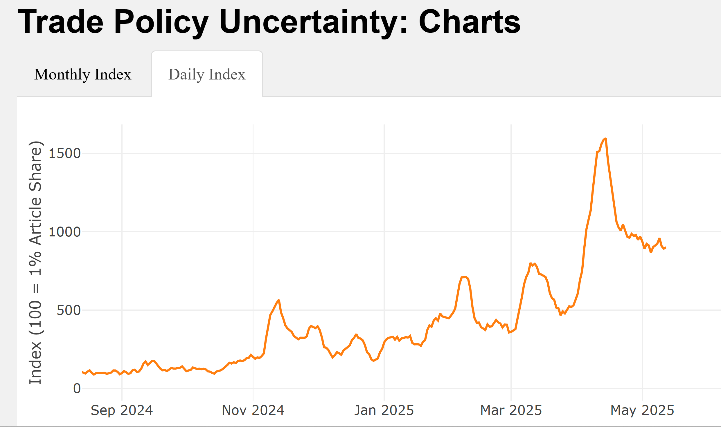
Why the Doom & Gloom
7 Day Average
“Liberation Day”
Inauguration
“Data downloaded from https://www.matteoiacoviello.com/tpu.htm on May, 14,2025).

Slide 43
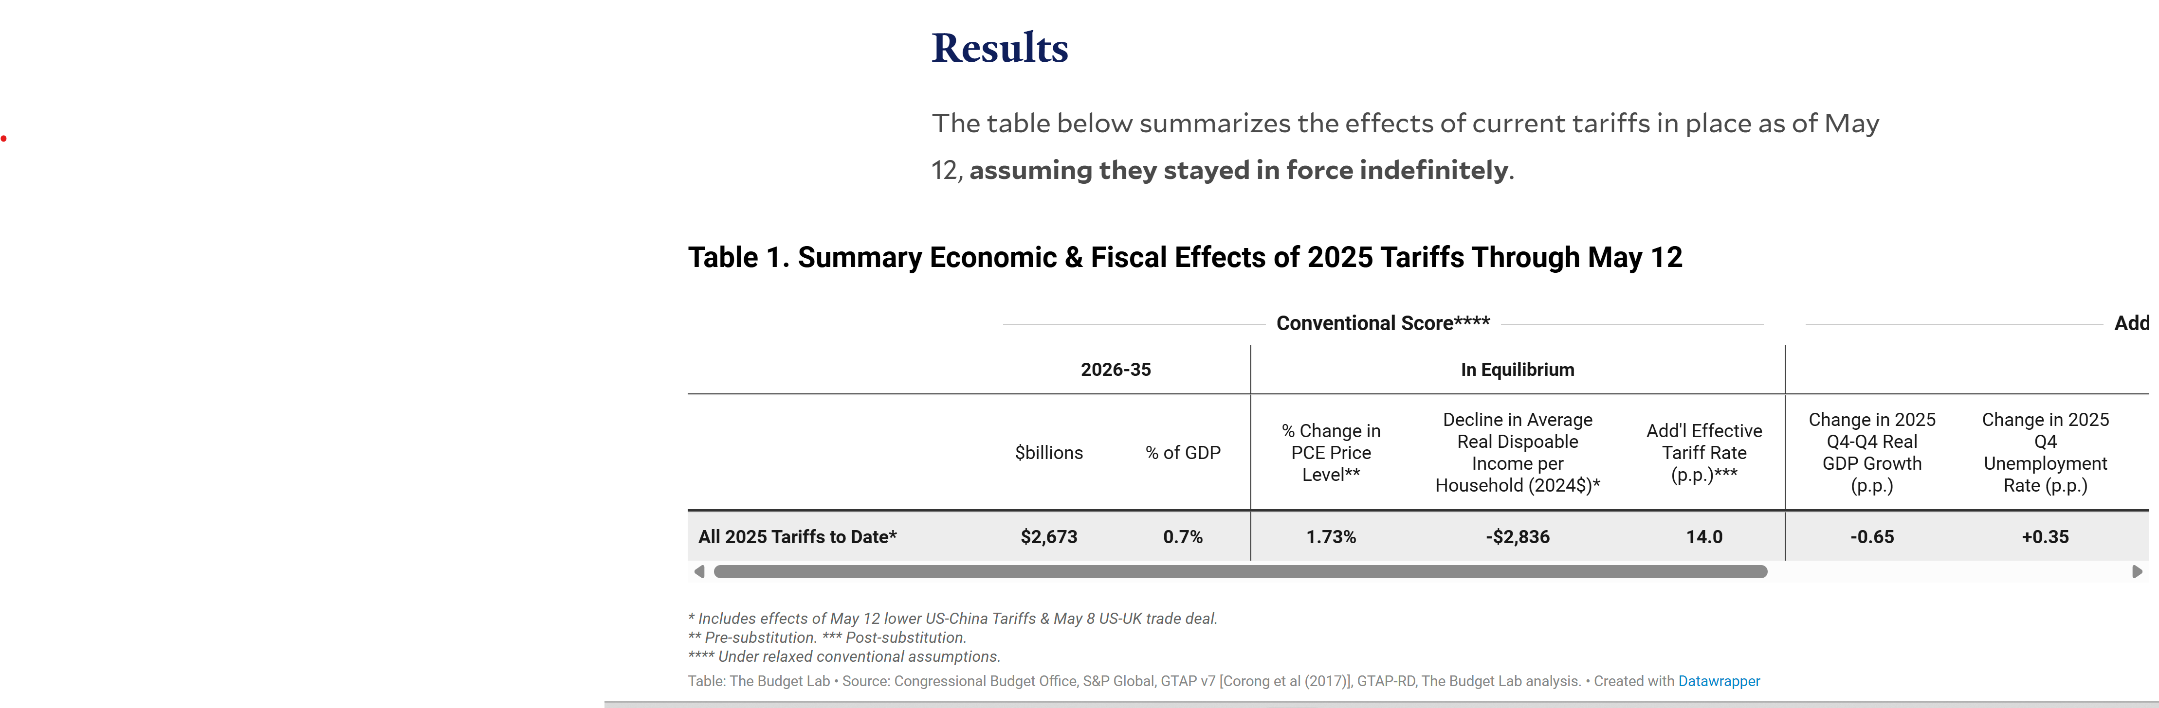
StagFlation and the Fed’s Dilemma
The Dilemma: To fight inflation the Fed needs to raise interest rates
To fight unemployment the Fed needs to lower interest rates
https://budgetlab.yale.edu/research/state-us-tariffs-may-12-2025

Slide 44
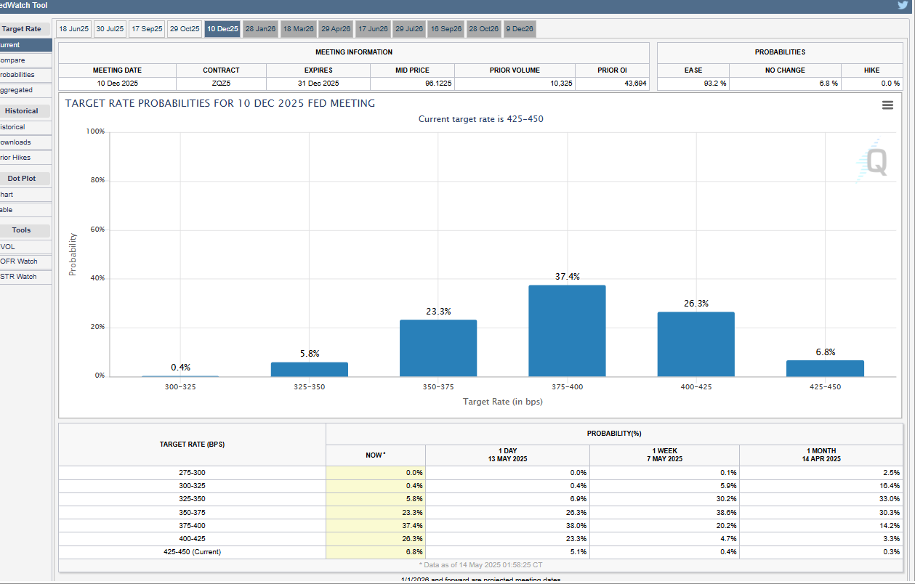
What Will the Fed Do?
https://www.cmegroup.com/markets/interest-rates/cme-fedwatch-tool.html

Slide 45
What Will Congress Do?
For detailed provisions https://taxfoundation.org/research/all/federal/big-beautiful-bill-house-gop-tax-plan/
https://www.crfb.org/blogs/adding-house-reconciliation-bill

Slide 46
Citizen’s Guide to “Budget Reconciliation.”
Procedure successfully used 22 times since 1974 to avoid a Senate filibuster.
Reconciliation can be used for changing taxes and spending (not Social Security) subject to the Byrd Rule.
Byrd rule:
  No extraneous provisions.
  No increase in the deficit after 10 year window.
Reconciliation games played by both parties:
  BBB.
  2017 Trump Tax Cut

Slide 47
Reconciliation and CBO Projections
For the CBO to be effective it must be perceived to be (and must be) nonpartisan.
Therefore, CBO “baseline” projections and legislative scoring must not try to predict changes in legislation.
Instead, CBO must analyze the data based on the current law as written (e.g., 2017 Personal Tax cuts expire this year).
CBO is allowed to provide analyses of policy options.
(“Options for Reducing the Deficit: 2025 to 2034,” https://www.cbo.gov/publication/60557”
Notes:
One exception: assumes SS will be paid

Slide 48
The Reconciliation Game in Action

Slide 49
Next Week: Immigration
About 10.6 million in 2022 (Latest data)
1 in 14 people born in Mexico currently lives in the US

Slide 50
My Google Site
https://sites.google.com/view/macro-current-issues/economic-update

Slide 51
Let’s Hear from You!
Geoffrey Woglom grwoglom@amherst.edu
Contact NEED: Info@NEEDEcon.org
Support NEED: www.NEEDEcon.org/donate.php

